Slide 1


BloomQuest
A Personalized Learning Platform based on Bloom’s Taxonomy and Knowledge based concepts.
Project ID : 2023-035

Slide 2
INTRODUCTION
Dedicated to empowering students on their self-study journey.
Aligned with the proven Bloom's Taxonomy approach.
Diverse quizzes tailored to various cognitive levels.
Visual learning with mind maps.
Advanced supplementary materials recommendation.
Performance tracking for insights and improvement.
Project ID : 2023-035

Slide 3
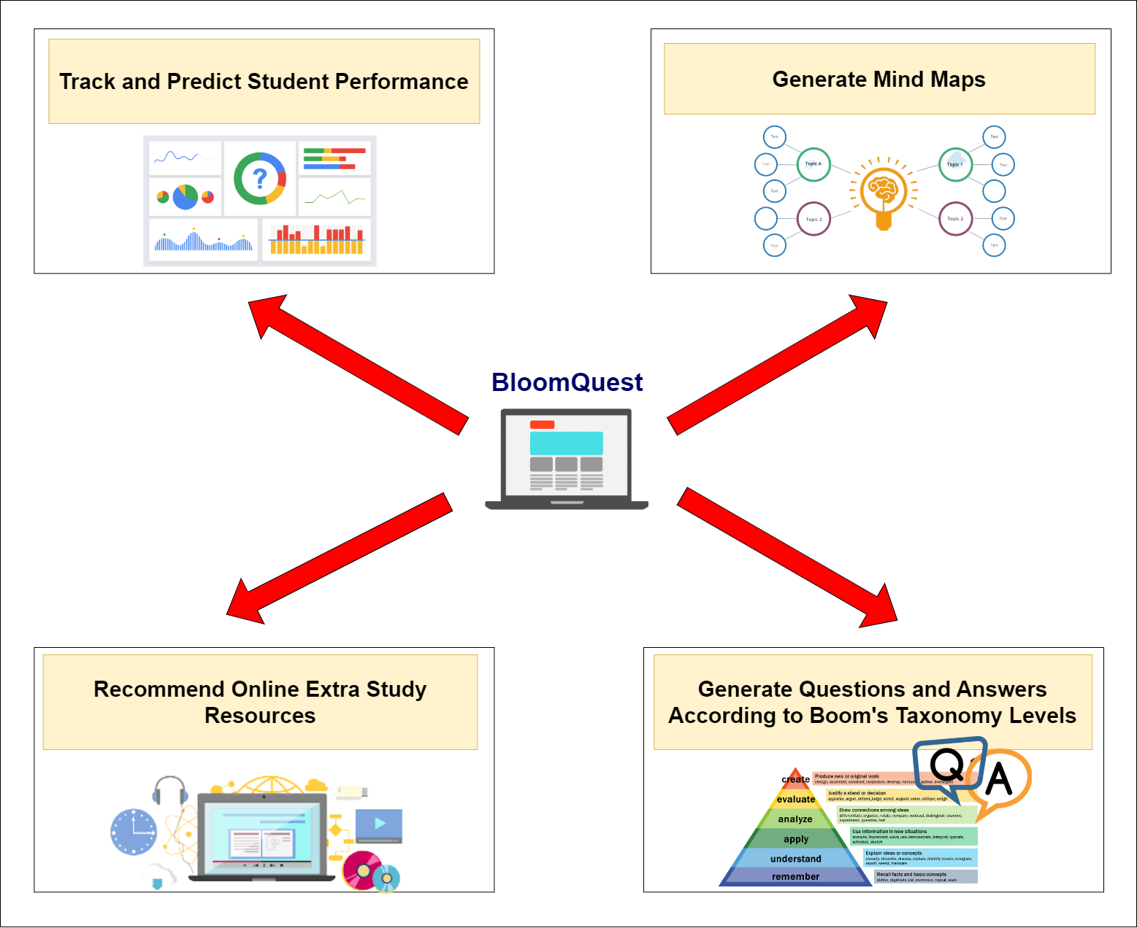
OVERALL SYSTEM
Project ID : 2023-035

Slide 4

IT20133504 | Weerasekara n. n.
Data Science
IT20133504 | Weerasekara N.N. | 2023-035

Slide 5
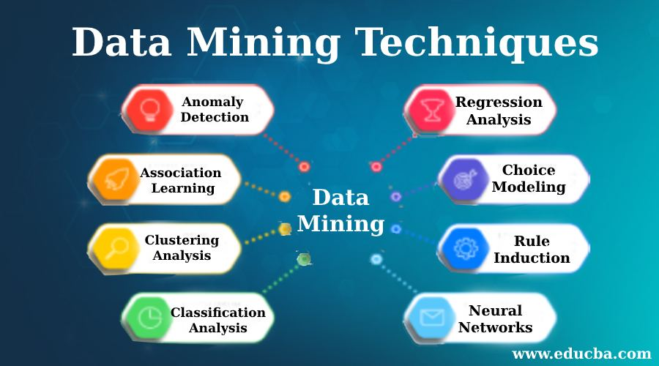
What do you think?
Paragraph
Mind Map
Data mining techniques are used to extract valuable information and insights from large datasets. These techniques can include machine learning algorithms, statistical analysis, clustering, association rule mining, and more. Some common techniques include association rule mining, which discovers relationships between variables, and clustering, which groups similar data points. Other techniques include classification, regression, decision trees, neural networks, text mining, time series analysis, anomaly detection, and ensemble methods. These techniques are applied in various fields such as finance, healthcare, marketing, and many more to gain insights and make data-driven decisions. By analyzing large datasets, data mining techniques can reveal patterns and trends that may be difficult to discern through manual analysis, leading to more efficient and effective decision making.
IT20133504 | Weerasekara N.N. | TMP-23-035

Slide 6
Background
What is a MIND MAP? - Mind mapping is a technique used for visually organizing information and concepts in a diagram or map. It's a widely-used method for note-taking, brainstorming, and idea organization.
Challenges with Mind Mapping- Many students don't use mind maps because they think making them is hard and requires creativity, which not everyone has. And the existing mind map generating tool have some limited capabilities.
IT20133504 | Weerasekara N.N. | 2023-035

Slide 7

Research Problem
"Can a Knowledge base system improve the usefulness of Mind-maps generated from text data compared to existing text mining algorithms and ML approaches?"

Slide 8
PROPOSED SOLUTION
To address this issue, I designed a tool to automatically generate mind maps based on a student's study material. This tool aims to help students who may struggle with mind map creation.
This research attempts to design a knowledge-based system that uses domain-specific knowledge to generate more precise and significant mind maps from text input in order to get over this constraint.

Slide 9
RESEARCH GAP
Previous Studies
This Study
Mainly use text mining algorithms and ML approaches.
The generation of mind maps often consumed a considerable amount of time
Only focused on creating mind maps for short text
Uses Knowledge-based concepts.
The process takes much more reasonable and efficient amount of time.
Extends this capability to handle longer text, offering a more comprehensive and versatile approach
VS
IT20133504 | Weerasekara N.N. | 2023-035

Slide 10
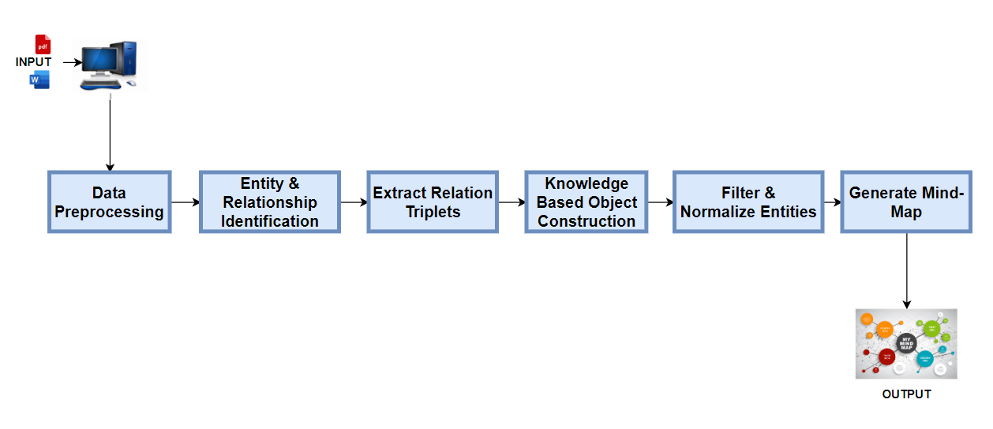
COMPONENT DIAGRAM
IT20133504 | Weerasekara N.N. | 2023-035

Slide 11
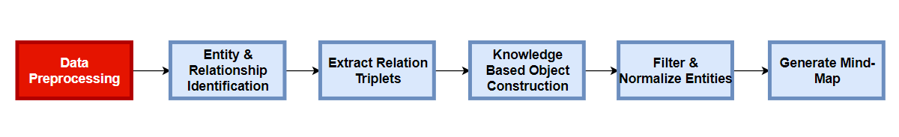
IMPLEMENTATION
Preprocess the paragraph Clean the text data by removing stop words, punctuations, etc.
IT20133504 | Weerasekara N.N. | 2023-035

Slide 12
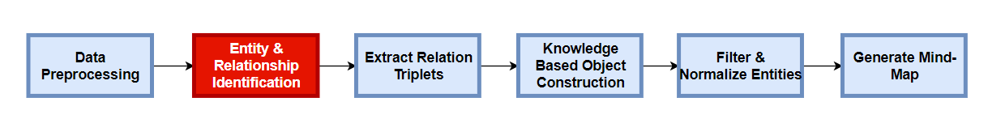
IMPLEMENTATION
Extract Entities and Relationships
Used a pre-trained model called REBEL, that is trained by Babel Scape to clearly identify the relations of a given text.
This model is used for sequence-to-sequence tasks, such as relation extraction
(We normally used named entity recognition(NER) and Relation Classification(RC) for these extraction, but these multiple steps often propagate errors and its only limited to small number of relation types.)

Slide 13
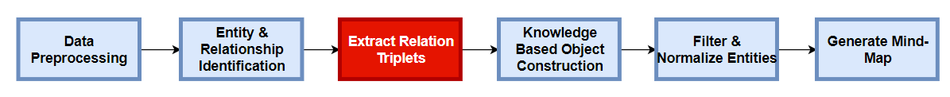
IMPLEMENTATION
Extract relation triplets from the text that has been processed by REBEL
For this I define a function called “extract_relations_from_model_output”.
This function takes a text as input, which is the output generated by REBEL.
It extracts relations from the model output by parsing the special tokens "<triplet>", "<subj>", and "<obj>“
It then constructs a list of relations, where each relation is represented as a dictionary with "head," "type," and "tail" attributes.

Slide 14
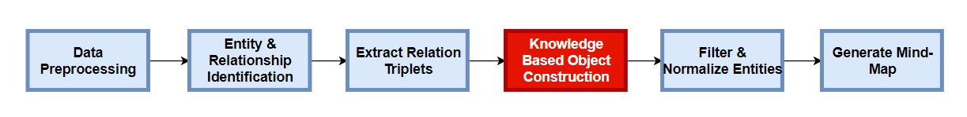
IMPLEMENTATION
Pass extracted triplets into a knowledge-based object
The Defined ‘KB’ (Knowledge Based) class is used to store and manage relations in a knowledge base.
This has methods to check if a relation exists, add a relation and print the relations in a ‘KB’.

Slide 15
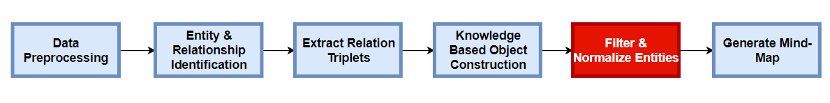
IMPLEMENTATION
Filter and normalize entities
The method that I implemented “are_relations_equal”, checks if two relations are equal based on their ‘head', 'type’ and ‘tail’ attributes
Used a python library called Wikipedia to validate extracted entities by checking if they have a corresponding Wikipedia page.

Slide 16
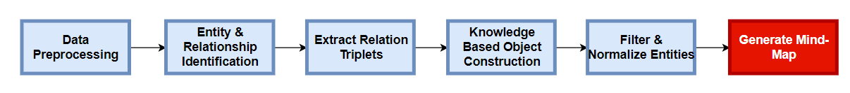
IMPLEMENTATION
Visualize the Mind-map
From the extracted relations stored in a knowledge base (KB) it creates a graph visualization of these relations using the Pyvis library. It then saves the resulting graph as an HTML file.

Slide 17
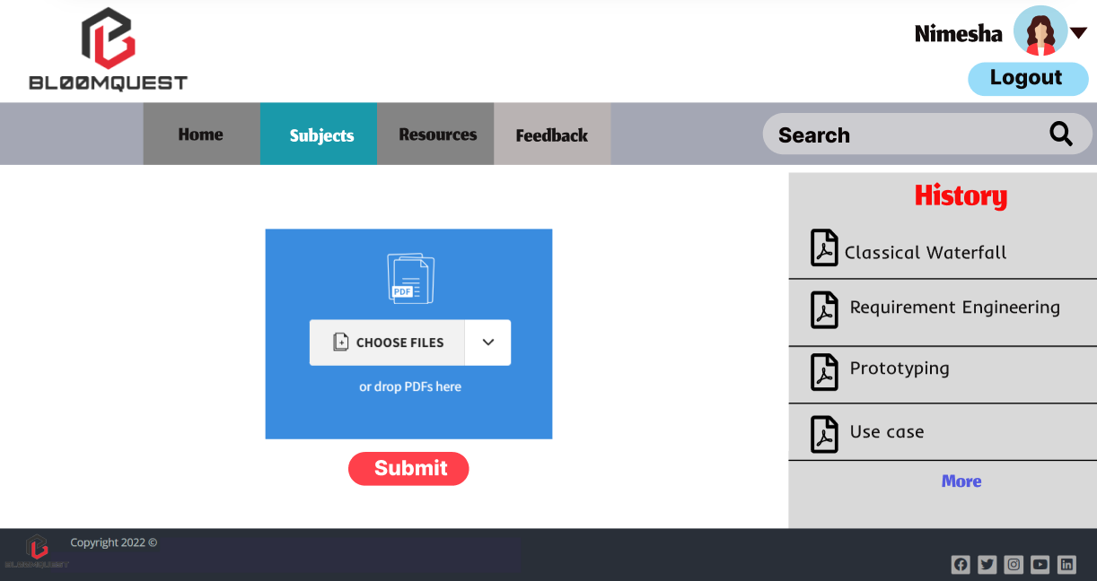
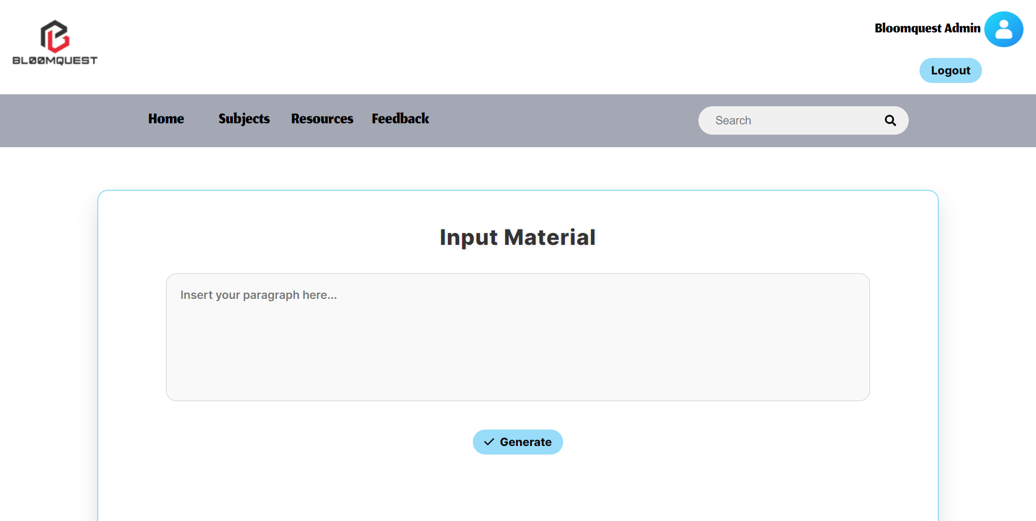
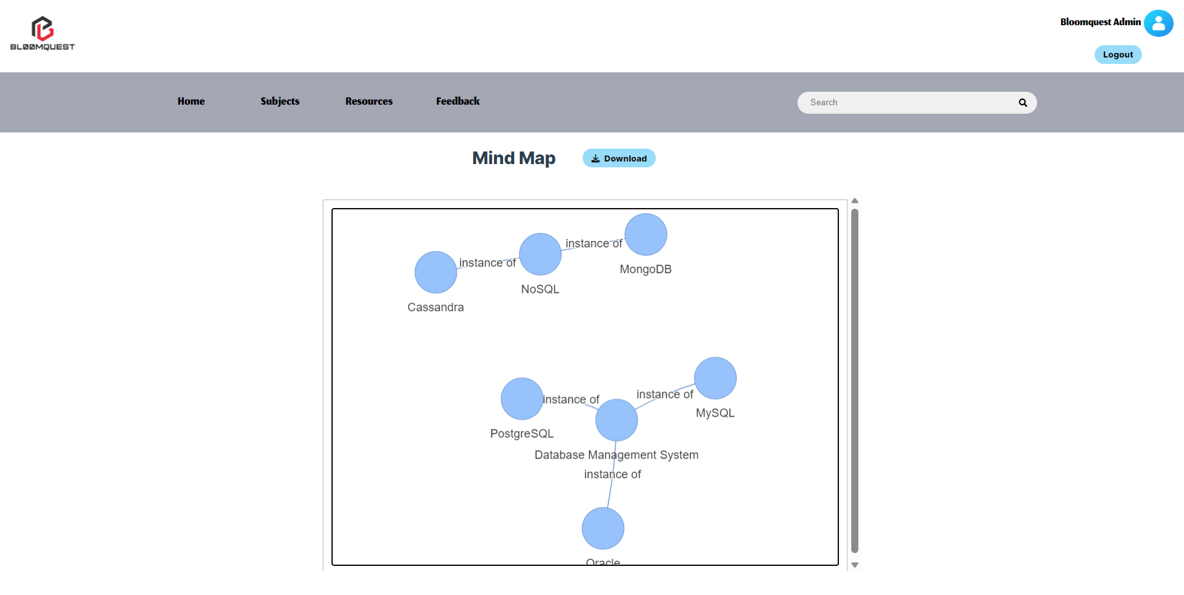
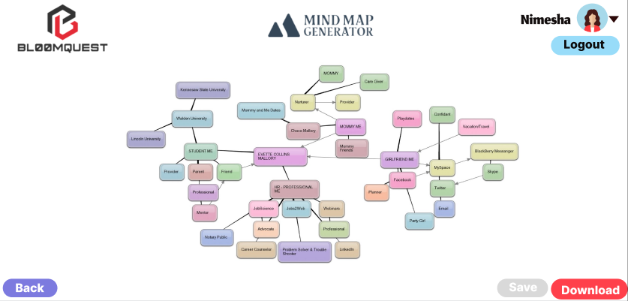
Prototype Design VS UI Design
UI Design
Prototype Design
IT20133504 | Weerasekara N.N. | 2023-035

Slide 18
NON-FUNCTIONAL REQUIREMENTS
Performance: The system process text and generate mind maps in a reasonable time frame. Splitting into Spans: When you have a long text, it can be challenging for the program to work with the whole thing at once. So, I implemented a function, you break the long text into smaller parts called "spans." Each span covers a chunk of the long text, and these spans overlap a little bit to make sure no information is missed.
Accuracy: Entity recognition and relation classification more accurate, it ensure the quality of the mind map.
Scalability: The system should handle both small and large study materials.
IT20133504 | Weerasekara N.N. | 2023-035

Slide 19
FUTURE WORK
Upgrade the input to be word or a pdf.
Enhance the Filtering and Normalization process.
Testing the usefulness of the Mind-map
IT20133504 | Weerasekara N.N. | 2023-035

Slide 20

IT20126438 | Colambage K.g
Data Science
IT20126438 | Colambage K.G | 22023-035

Slide 21


Background
What is Generate a set of questions and answers using knowledge graph and categorize them according to bloom’s taxonomy?
Generating a set of questions and answers using a knowledge graph involves extracting information from a structured representation of knowledge and transforming it into a set of questions and answers. Bloom's taxonomy is a framework for categorizing educational goals and objectives into levels of cognitive complexity. Categorizing the questions and answers generated by the knowledge graph according to Bloom's taxonomy involves mapping them to the appropriate level of cognitive complexity, such as remembering, understanding, applying, analyzing, evaluating, or creating. This can help ensure that the questions and answers are appropriate for the level of learning intended and can guide the design of instructional materials and assessments
• Why do we say that it’s useful ?
If you have enough knowledge about Bloom’ taxonomy level, you can handle how to face the questions by categorizing Bloom’ taxonomy level
IT20126438 | Colambage K.G | TMP-23-035

Slide 22
Research Problem
"How can generating questions and answers and categorizing them according to Bloom's taxonomy is the limited availability of question generation techniques specifically designed to align with the taxonomy .?"
IT20126438 | Colambage K.G | 22023-035

Slide 23

PROPOSED SOLUTION
Develop a question generation framework that explicitly incorporates the cognitive complexity levels defined by Bloom's taxonomy. The framework can utilize natural language processing techniques, machine learning algorithms, and educational domain knowledge to automatically generate questions that align with the desired taxonomy level.
IT20126438 | Colambage K.G | 22023-035

Slide 24
RESEARCH GAP
Previous Studies
This Study
That generates, multiple-choice questions based on lecture notes. Use NLG
Generate True or false Questions and multiple choice Questions based on Paragraph. Use NLP
VS
Generating self-study questions with a knowledge graph and Bloom's Taxonomy to generating quiz questions.
Exam Based Self learning system Generate Questions & Answers Categorize Bloom's Taxonomy level.
IT20126438 | Colambage K.G | 22023-035

Slide 25
RESEARCH GAP
Previous Studies
This Study
Question contain mostly keyword associated Analyzing , Understading, Remembering level then can categories in to 3 levels..
contain mostly keyword associated Analyzing level
VS
focused on either question generation or Bloom's categorization,
Simultaneously Generate Both Questions generation and Categerization.
IT20126438 | Colambage K.G | 22023-035

Slide 26
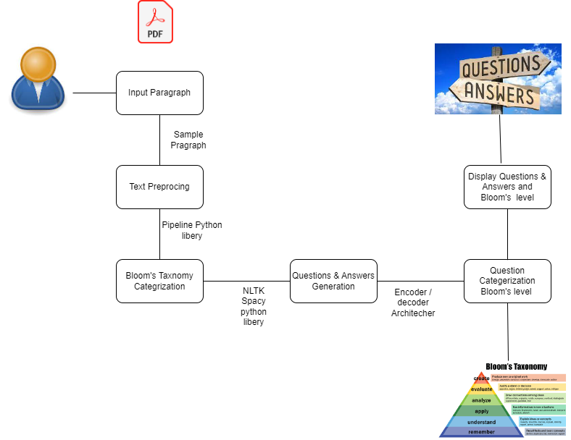
COMPONENT DIAGRAM
IT20126438 | Colambage K.G | 22023-035

Slide 27
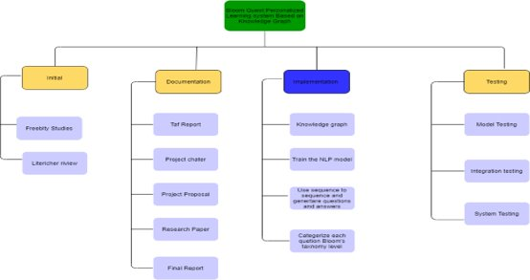
WORK BREAKDOWN
IT20126438 | Colambage K.G | 22023-035

Slide 28
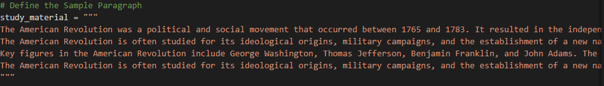
Text Preprocessing the input paragraph : Text Preprocessing: Tokenize the input paragraph into sentences and words. Remove any stop words and punctuation. Perform stemming or lemmatization to reduce words to their base forms. used NLP rule based apporch.
IMPLEMENTATION
IT20126438 | Colambage K.G | 2023-035

Slide 29
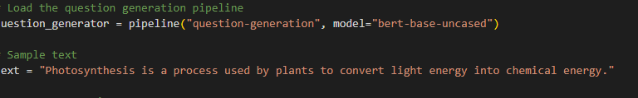
IMPLEMENTATION
Text Classification:​
Use a pre-trained NLP model or train our own text classifier to categorize each sentence in the input paragraph into one of the Bloom's taxonomy levels (e.g., Knowledge, Comprehension, Application, Analysis, Synthesis, Evaluation).using the Tokenization library. Pypeline python libery then output is that.
IT20126438 | Colambage K.G | 22023-035

Slide 30
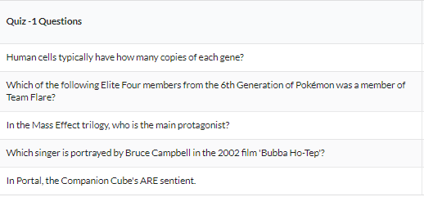
IMPLEMENTATION
Question Generation:
For each sentence categorized at a specific Bloom's level, generate questions that correspond to that level. The questions should align with the cognitive skills associated with that level (e.g., "What is X?" for Knowledge, "How does X relate to Y?" for Comprehension, etc.). The use a question generation r rule-based techniques to generate questions and Transformer python Libery used And Encoder Architecture.
IT20126438 | Colambage K.G | 22023-035

Slide 31
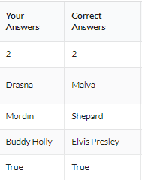
IMPLEMENTATION
Answer Extraction: ​
For each generated question, extract relevant answers from the input paragraph. use Named Entity Recognition (NER) or information retrieval techniques to find answers. Using Decoder Architecture and Transformes Python Libery Develop
IT20126438 | Colambage K.G | 22023-035

Slide 32
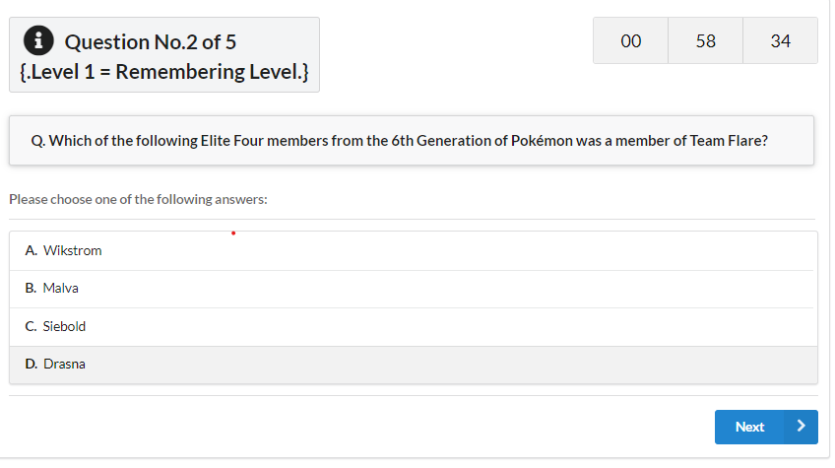
IMPLEMENTATION
Display Questions, Answers, and Bloom's Level:
Organize the generated questions, answers, and their corresponding Bloom's taxonomy levels. Display the results in a user-friendly format. Using the NLTK python libery. And spacy

Slide 33
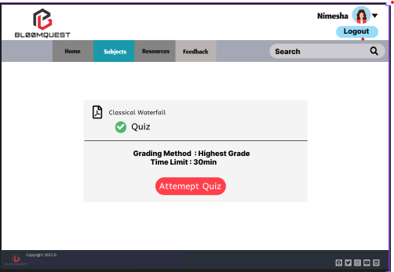
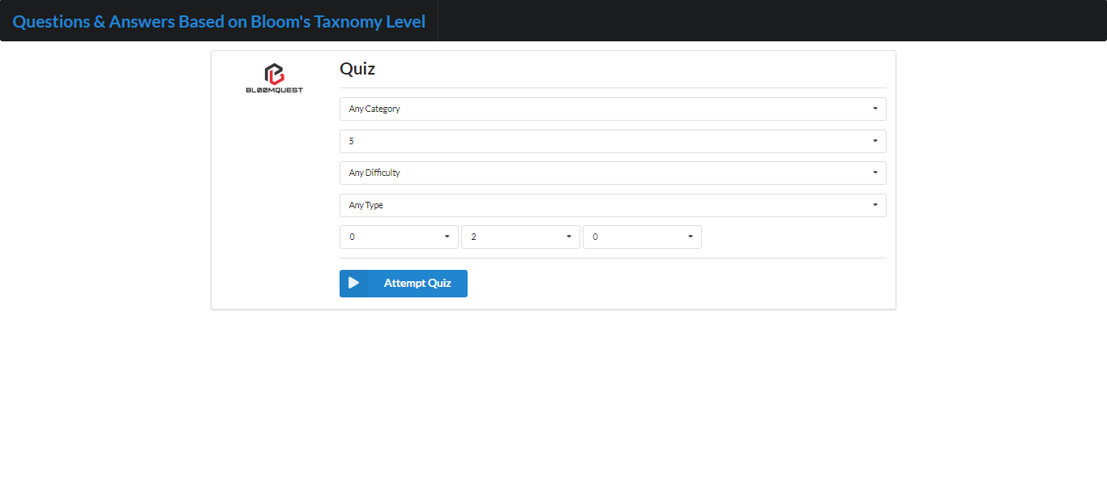
PROTOTYPE VS UI DESIGN
IT20126438 | Colambage K.G | 22023-035

Slide 34
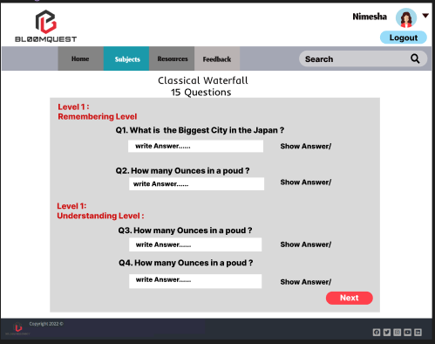
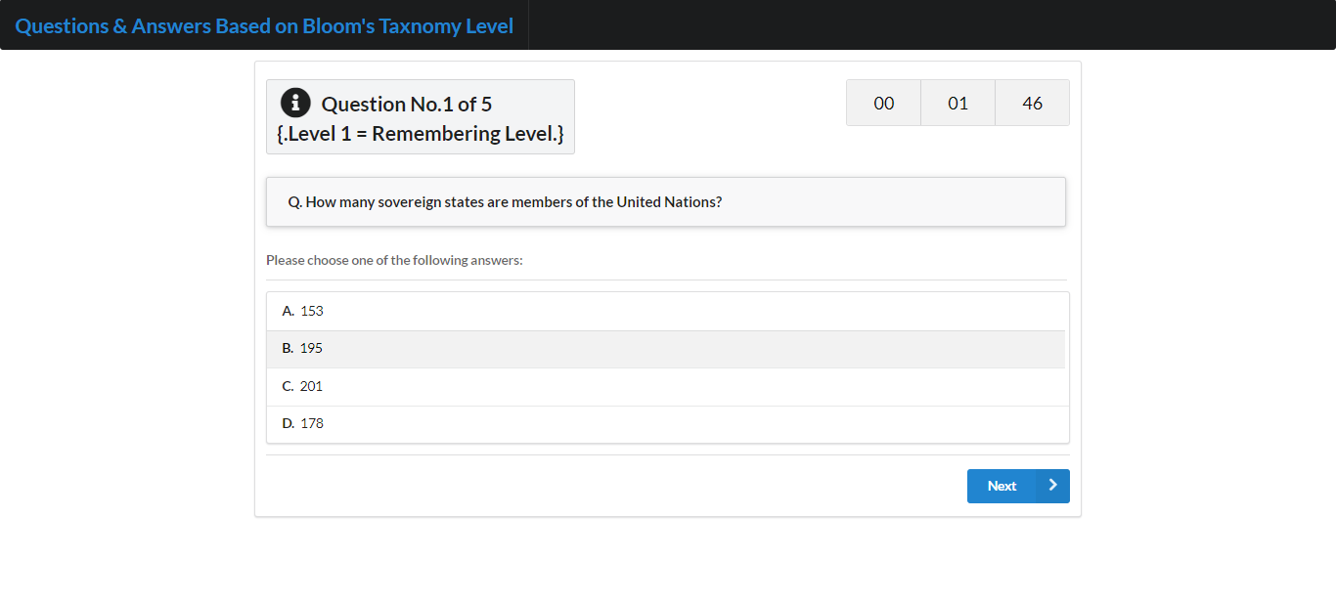
PROTOTYPE VS UI DESIGN

Slide 35
NON-FUNCTIONAL REQUIREMENTS
​
Performance: Your component should be able to generate questions and answers quickly and efficiently, even with large amounts of data.​
Scalability: The component should be designed to handle increasing amounts of data and user traffic over time.​
Usability: The user interface should be intuitive and easy to use for both technical and non-technical users.​
Security: The component should be designed to prevent unauthorized access and protect sensitive data.​
IT20126438 | Colambage K.G | 22023-035

Slide 36
FUTURE WORK
Categorize Bloom's levels in Questions. 2 levels
Improve 10 Questions.
IT20126438 | Colambage K.G | 22023-035

Slide 37

TRACK AND PREDICT STUDENT PERFORMANCE USING
BLOOM’S TAXONOMY METRICS.
IT20123468 | SENAWEERA T.I.S
Software Engineering
IT20123468 | Senaweera T.I.S. | 2023-035

Slide 38

RESEACRH PROBLEM
“How can university students assess their academic performance level while doing
self-studies?”
IT20123468 | Senaweera T.I.S. | 2023-035

Slide 39

PROPOSED SOLUTION
“Develop a method to predict student performance utilizing Bloom's Taxonomy levels.”
IT20123468 | Senaweera T.I.S. | 2023-035

Slide 40
RESEARCH GAP
Previous Studies
This Study
Primarily predict student performance for university decision-makers or higher education providers.
Few have used Bloom's Taxonomy as a standard metric.
Lack of visualization tools for student performance in most studies.​
Focuses on a tool for individual students to predict their own academic performance.
Performance prediction based on Bloom's taxonomy.
Strong emphasis on visualization of performance.
VS
IT20123468 | Senaweera T.I.S. | 2023-035

Slide 41
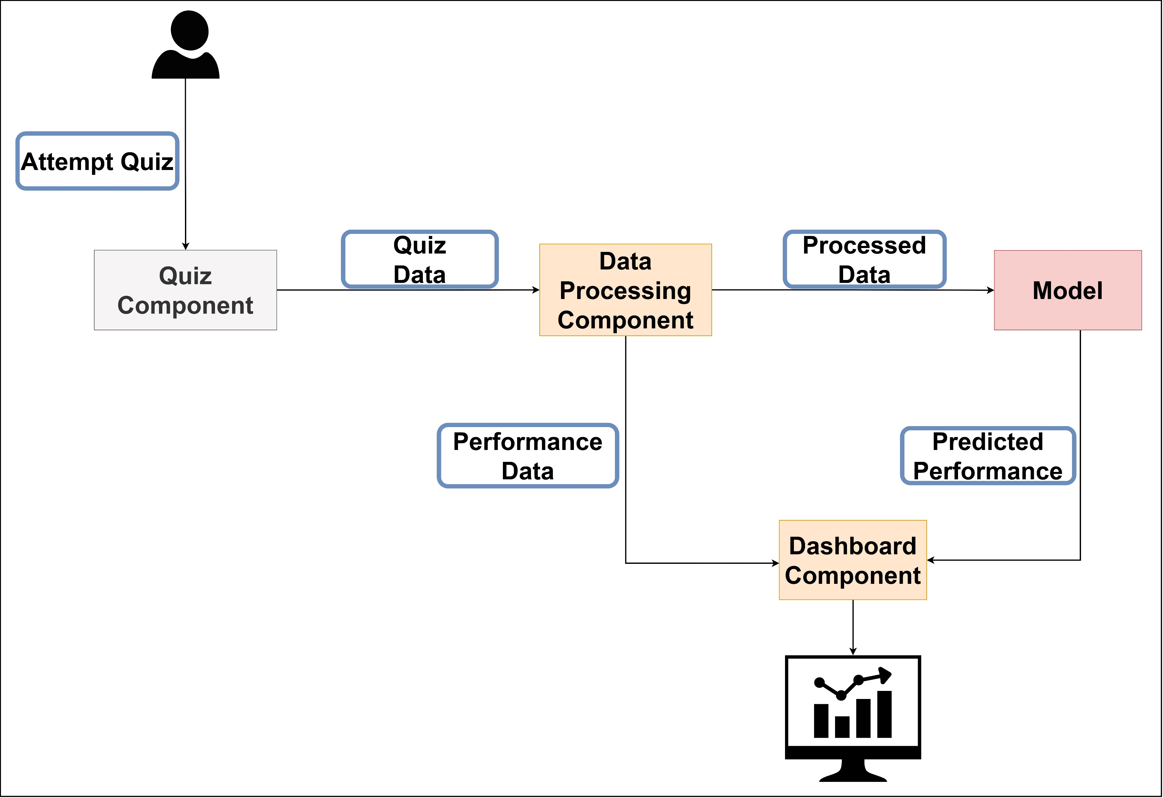
COMPONENT DIAGRAM
IT20123468 | Senaweera T.I.S. | 2023-035

Slide 42
DATA COLLECTION
1. Participants:
124 students who studied database management systems module.
2. Methods of Data Collection:
Collected marks of the students for,
Quizzes
Mid Exam
Final Exam
Mid exam paper and quizzes questions were categorized into,
L1: Remember & Understand
L2: Apply
L3: Analyze, Create & Evaluate
IT20123468 | Senaweera T.I.S. | 2023-035

Slide 43
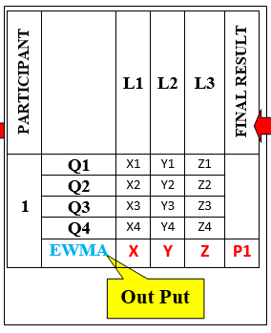
DATA PREPARATION
Datasets
Dataset 1
Dataset 2
Calculating EWMA (Exponentially Weighted Moving Average):
Aggregated L1 marks from all 3 quizzes and mid exam.
Aggregated L2 marks from all 3 quizzes and mid exam.
Aggregated L3 marks from all 3 quizzes and mid exam.
Data Attributes:
Final Mark of Quiz 1.
Final Mark of Quiz 2.
Final Mark of Quiz 3.
Final Mark of Mid Exam.
Final Exam Mark Dependent variable
EWMA(t)=α×x(t)+(1−α)×EWMA(t−1)
Independent Variables
Data Attributes:
Calculated EWMA(L1).
Calculated EWMA(L2).
Calculated EWMA(L3).
Final Exam Mark.
Independent Variables
Dependent variable
IT20123468 | Senaweera T.I.S. | 2023-035

Slide 44
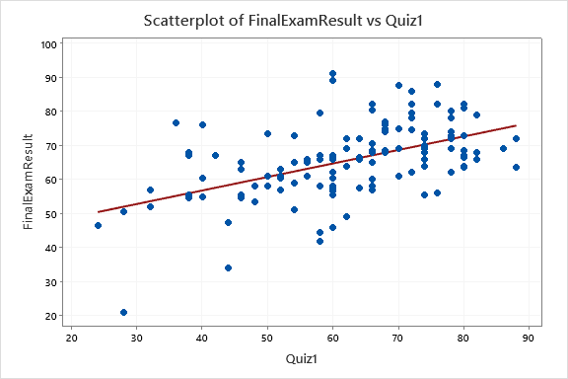
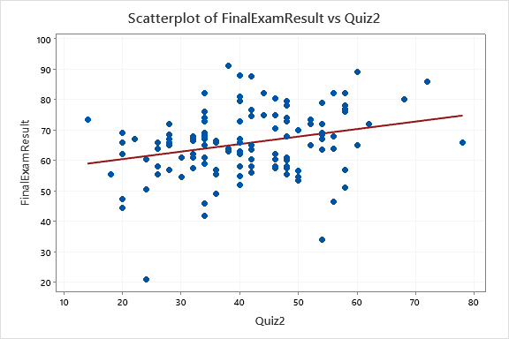
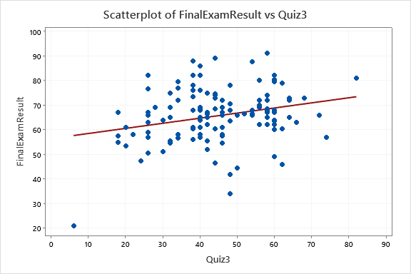
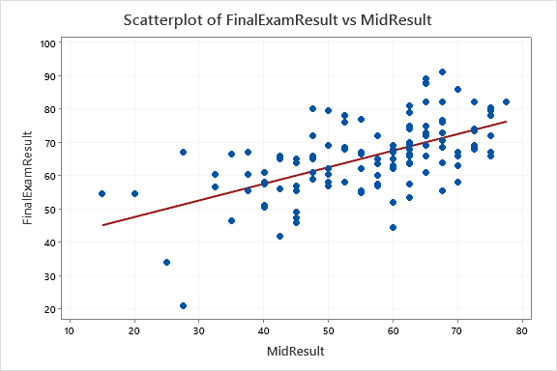
DATA ANALYSIS
1. Relationship Between Quizzes, Mid Marks with Final Exam Result.
Quiz 1 vs Final Exam Result
Quiz 2 vs Final Exam Result
Quiz 3 vs Final Exam Result
IT20123468 | Senaweera T.I.S. | 2023-035
Mid Exam vs Final Exam Result

Slide 45
DATA ANALYSIS
1. Relationship Between Quizzes, Mid Marks with Final Exam Result.
Pearson Correlations:
Y | X | N | Correlation | 95% CI for ρ | P-Value
Final Exam Result | Quiz 1 | 124 | 0.509 | (0.366, 0.629) | 0.000
Final Exam Result | Quiz 2 | 124 | 0.275 | (0.103, 0.430) | 0.002
Final Exam Result | Quiz 3 | 124 | 0.256 | (0.084, 0.414) | 0.004
Final Exam Result | Mid Result | 124 | 0.591 | (0.463, 0.695) | 0.000
There is a good correlation between all quizzes and mid exam results with Final Exam Result.
Quiz 2 and quiz 3 correlation with final exam result is a moderate correlation.
IT20123468 | Senaweera T.I.S. | 2023-035

Slide 46
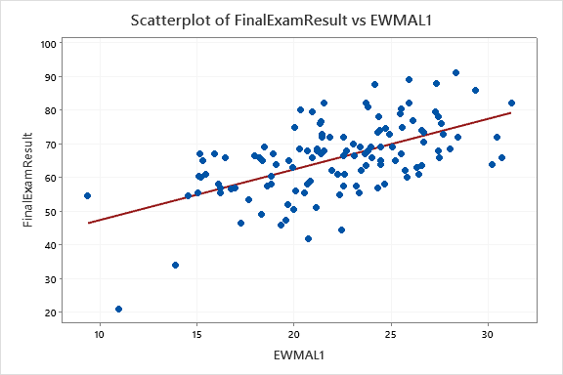
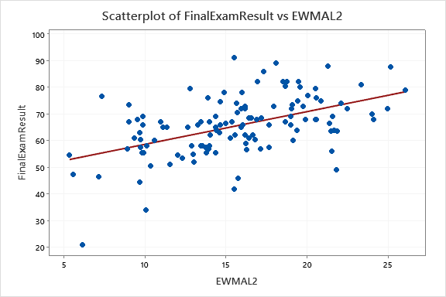
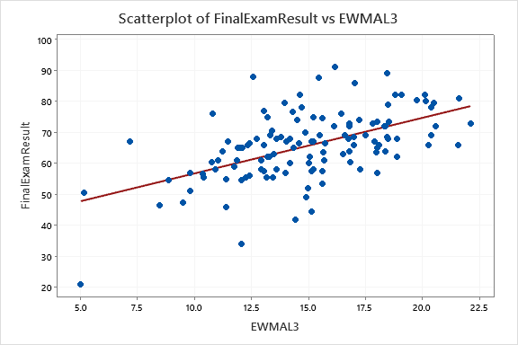
DATA ANALYSIS
3. Relationship Between Blooms Levels L1, L2, L3 with Final Exam Result.
L1 vs Final Exam Result
L2 vs Final Exam Result
L3 vs Final Exam Result
IT20123468 | Senaweera T.I.S. | 2023-035

Slide 47
DATA ANALYSIS
3. Relationship Between Blooms Levels L1, L2, L3 with Final Exam Result.
Pearson Correlations:
Y | X | N | Correlation | 95% CI for ρ | P-Value
Final Exam Result | EWMA L1 | 124 | 0.576 | (0.445, 0.683) | 0.000
Final Exam Result | EWMA L2 | 124 | 0.507 | (0.363, 0.627) | 0.000
Final Exam Result | EWMA L3 | 124 | 0.547 | (0.410, 0.659) | 0.000
There is a strong correlation between L1, L2, L3 with Final Exam Result.
IT20123468 | Senaweera T.I.S. | 2023-035

Slide 48
MODEL FITTING
Linear Regression Model
Regression Equation
FinalExamResult = 25.99 + 0.879 EWMAL1 + 0.627 EWMAL2 + 0.694 EWMAL3
Model Summary
R-sq | R-sq(adj) | R-sq(pred)
55.89%​ | 54.07%​ | 50.53%​
IT20123468 | Senaweera T.I.S. | 2023-035

Slide 49
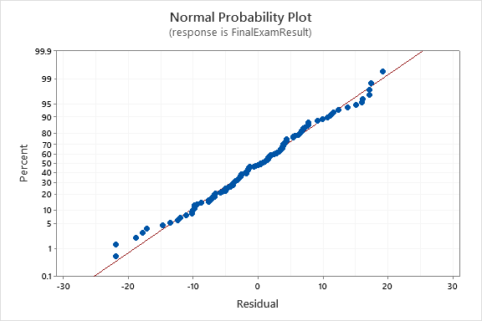
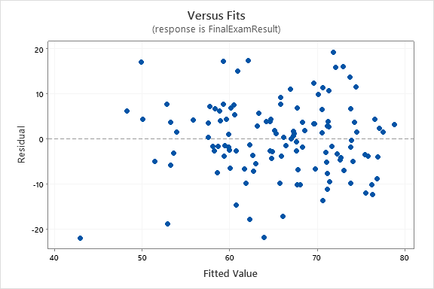
MODEL ASSUMPTION CHECKING
Linear Regression Assumptions are Validated.
IT20123468 | Senaweera T.I.S. | 2023-035

Slide 50
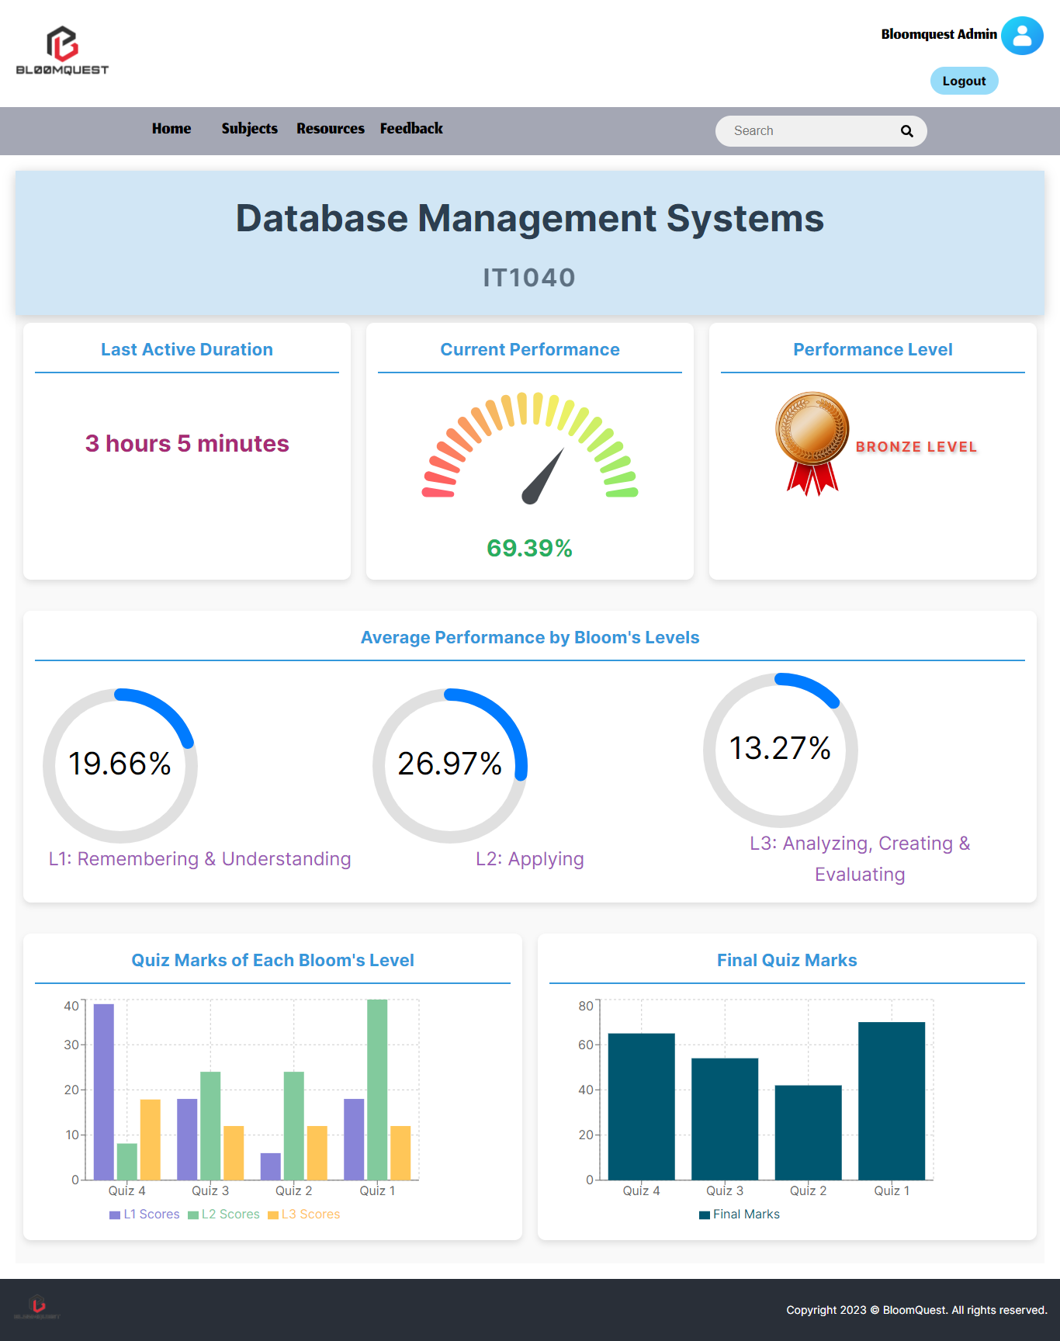
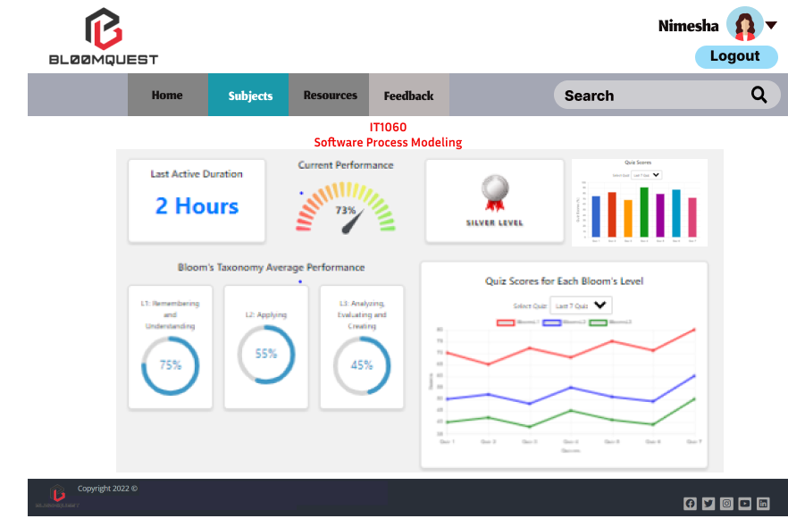
PROTOTYPE VS UI DESIGN
Prototype Design
UI Implementation
IT20123468 | Senaweera T.I.S. | 2023-035

Slide 51
NON-FUNCTIONAL REQUIREMENTS
User-friendly and visually appealing interface.
Modularity of components for easy maintenance.
Availability, ensuring students can access it when needed.
Ensure only authenticated users can access their data, and they have the right permissions.
IT20123468 | Senaweera T.I.S. | 2023-035

Slide 52
FUTURE WORK
Use other modeling techniques - Decision tree regression, random forest regression.
Enhance dashboard visualization.
Testing.
IT20123468 | Senaweera T.I.S. | 2023-035

Slide 53
REFERENCES
G. N. R. Prasad, “Evaluating student performance based on bloom’s taxonomy levels,” in Journal of Physics: Conference Series, IOP Publishing Ltd, Mar. 2021. doi: 10.1088/1742-6596/1797/1/012063.
H. Darman, S. Musa, R. Ramasamy, and R. Rajeswari, “Predicting Students’ Final Grade in Mathematics Module using Multiple Linear Regression,” 2019.
M. A. Ma’sum, “Predicting Student Achievement before Final Exam: A Regression-Based Approach,” in 2022 2nd International Conference on Information Technology and Education, 2022.
“Exponentially Weighted Moving Average (EWMA),” Corporate Finance Institute, CFI Team. Accessed: Aug. 2023. [Online]. Available: https://corporatefinanceinstitute.com/resources/capital-markets/exponentially-weighted-moving-average-ewma/
IT20123468 | Senaweera T.I.S. | 2023-035

Slide 54

IT20133368 | Wijayasena w.d.n.d.t
Data Science
IT20133368 | Wijayasena W.D.N.D.T. | 2023-035

Slide 55
RESEACRH PROBLEM
How can the declining interest of students in seeking and engaging with recommended extra resources during university lectures be addressed effectively?
IT20133368 | Wijayasena W.D.N.D.T. | 2023-035

Slide 56
PROPOSED SOLUTION
Develop a system that provides personalized recommendations of highly relevant and popular extra resources based on the student's uploaded paragraph .
IT20133368 | Wijayasena W.D.N.D.T. | 2023-035

Slide 57
RESEARCH GAP
Previous Studies
This Study
Optimized for shorter keyword-based queries without deep semantic analysis.
Ignored suitability based on reader's level.
Designed for long query paragraphs, using LDA to extract semantic topics and understand context.
Measures reading difficulty to ensure recommendations match the reader's level.
VS
IT20133368 | Wijayasena W.D.N.D.T. | 2023-035

Slide 58
RESEARCH GAP
Previous Studies
This Study
Incorporates both relevance and reading difficulty for resource recommendation.
Incorporates both content relevance and video engagement metrics such as views, likes, and comments.
Ranked resources based solely on relevance to user request.
VS
IT20133368 | Wijayasena W.D.N.D.T. | 2023-035

Slide 59
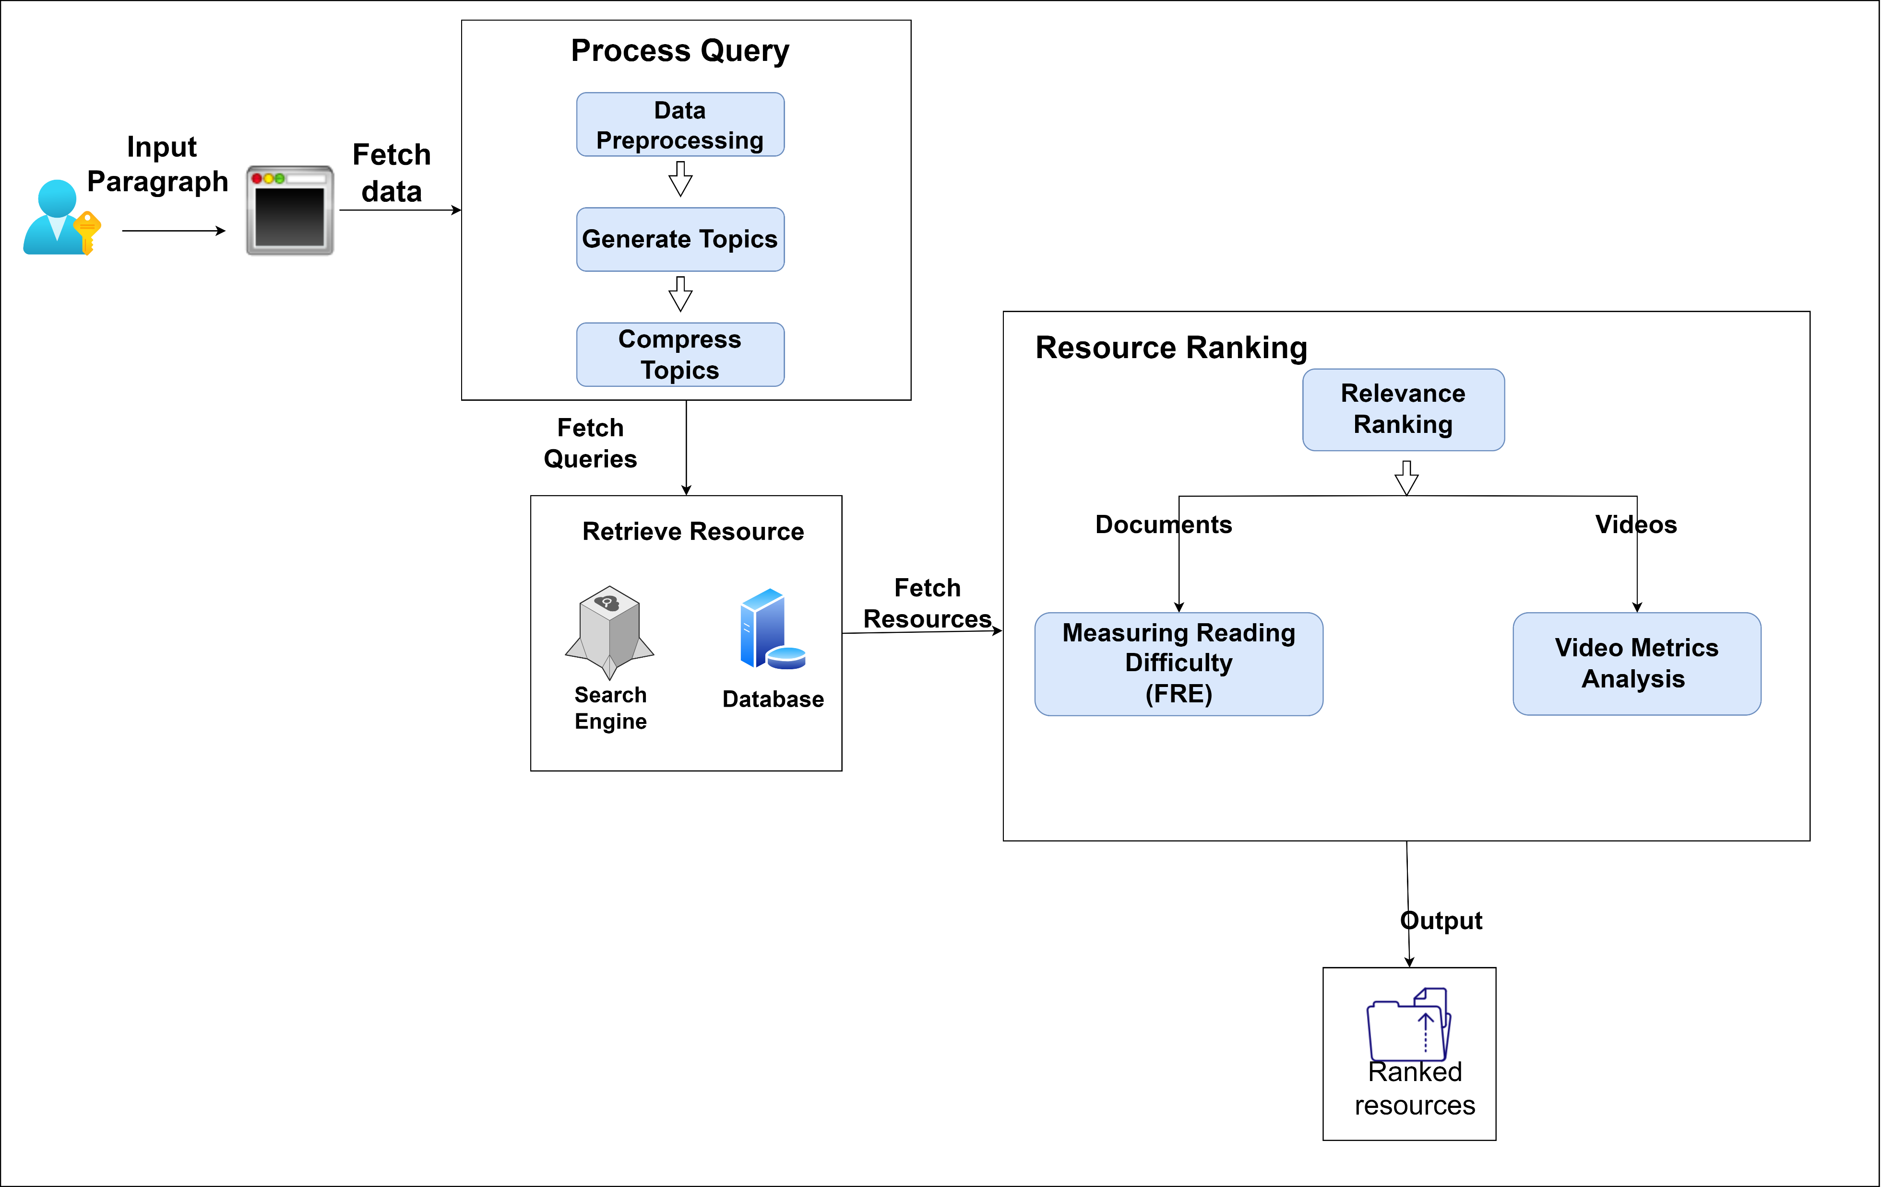
COMPONENT DIAGRAM
IT20133368 | Wijayasena W.D.N.D.T. | 2023-035

Slide 60
IMPLEMENTATION
Inputs to the System
Textual Input: The system receives textual input from students, which can include essays, questions, or any text-based educational content with any length.
User Proficiency Level: If provided or inferred, the system considers the user's proficiency level to suggest resources suitable for their skill level.
Resource Type Selection: Users may specify their preference for resource types, such as documents or videos, influencing the recommendation results.
IT20133368 | Wijayasena W.D.N.D.T. | 2023-035

Slide 61
IMPLEMENTATION
Output of the System
Document Recommendations: The system suggests relevant documents, such as articles, research papers, or study guides, based on the user's input.
Video Recommendations: For users who prefer video content, the system offers video recommendations, including educational lectures, tutorials, and demonstrations.
Topic-Based Resources: The system categorizes recommended resources by topics or subjects, making it easy for users to explore materials related to their areas of interest.
Content Metrics: Each recommended resource includes metrics like readability, difficulty level, and content length, ensuring that users can assess the suitability of the material at a glance.
IT20133368 | Wijayasena W.D.N.D.T. | 2023-035

Slide 62
IMPLEMENTATION
Methodology of the System
Tokenization: The paragraph is tokenized, which means it is split into individual words or tokens.
Stop word Removal: Stop words are common words (e.g., "the," "and" "in") that often don't carry significant meaning for analysis.
Collect and preprocess input query
IT20133368 | Wijayasena W.D.N.D.T. | 2023-035

Slide 63
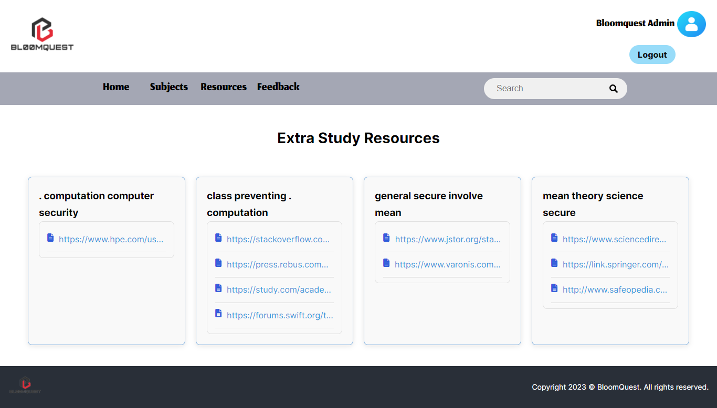
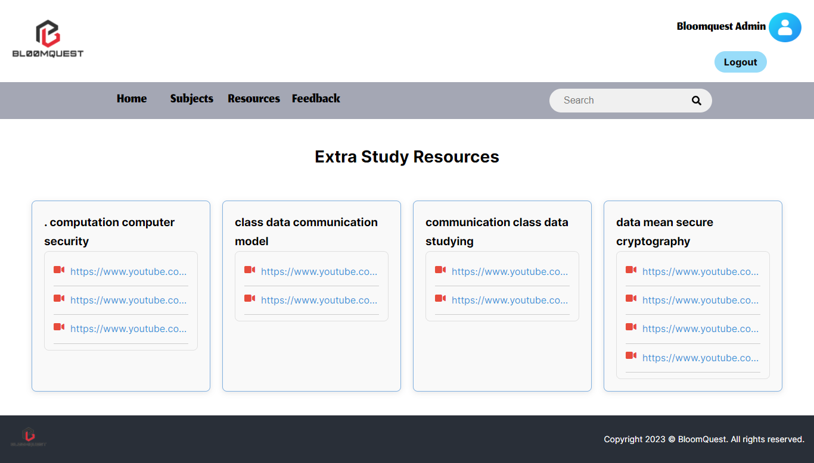
IMPLEMENTATION
2. Retrieve Resources
For Documents: Documents are retrieved from the web using a web scraping technique.
For Videos: Videos are sourced from YouTube using the YouTube Data API.
IT20133368 | Wijayasena W.D.N.D.T. | 2023-035

Slide 64
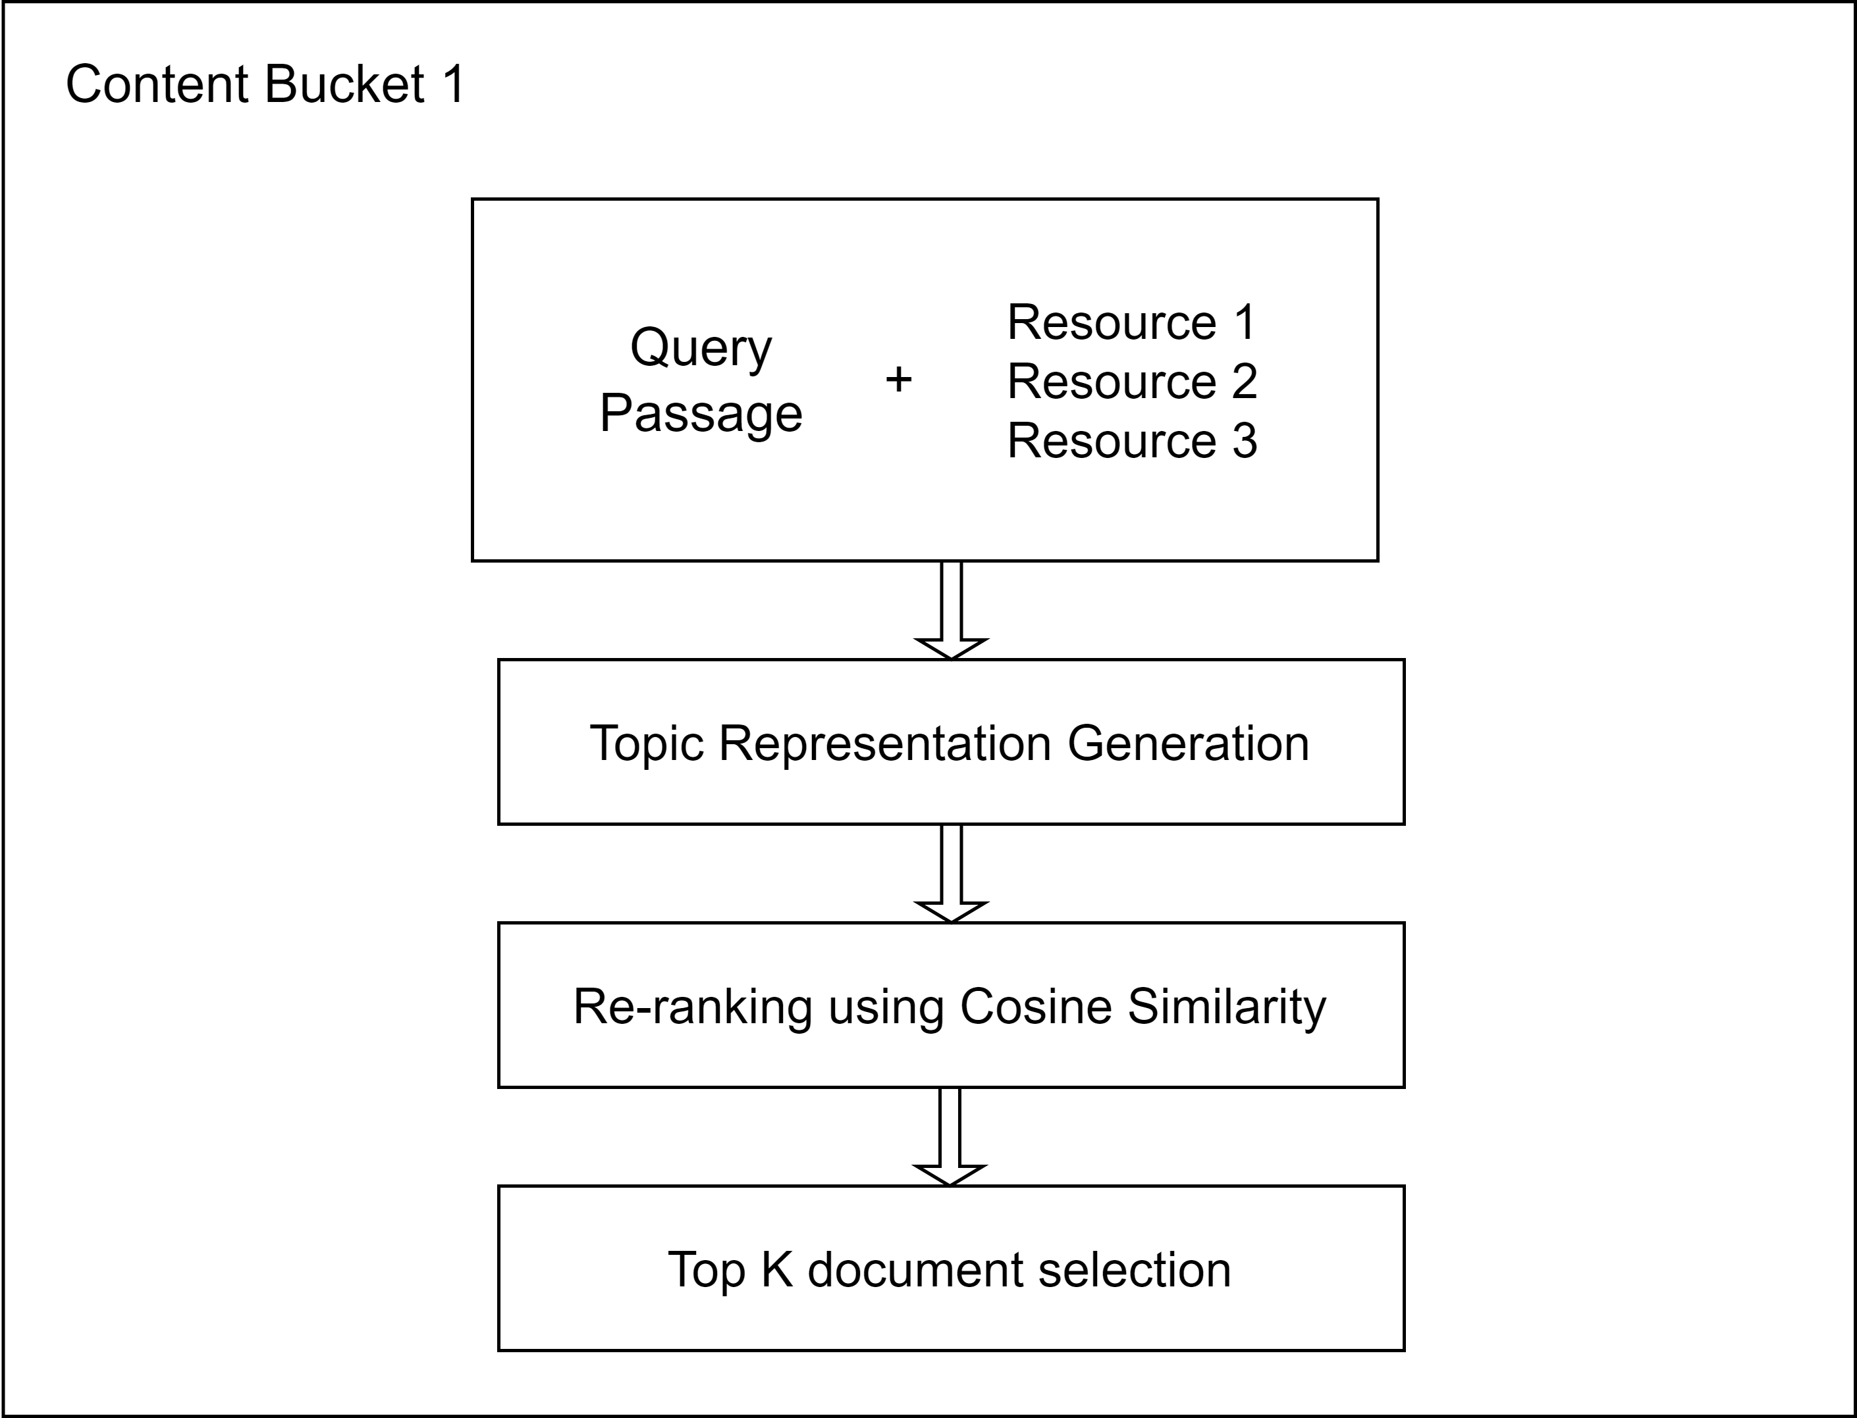
IMPLEMENTATION
3. Ranking Resources - Relevance Ranking
Content Buckets: Each set of candidate resources + original query passage = Content Bucket.
Semantic features (topics) generated for each bucket.
Re-Ranking Process:
Utilizes topic representations (topics) for documents and the query.
Re-ranks documents in the content bucket.
Employs cosine similarity (or any suitable similarity metric).
Top-k Selection:
Selects the top-k (k < K) documents for each query topic.
Based on query passage analysis.
IT20133368 | Wijayasena W.D.N.D.T. | 2023-035

Slide 65
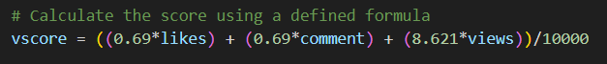
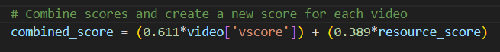
IMPLEMENTATION
3. Ranking Resources – Video Ranking
Considered multiple key metrics from YouTube videos such as likes, view count, and comment count and create a formula to get a score.
Combined vscore, reflecting video engagement, with the Relevance Ranking Score using a weighted formula to provide users with video recommendations that balance both content relevance and quality.
IT20133368 | Wijayasena W.D.N.D.T. | 2023-035

Slide 66
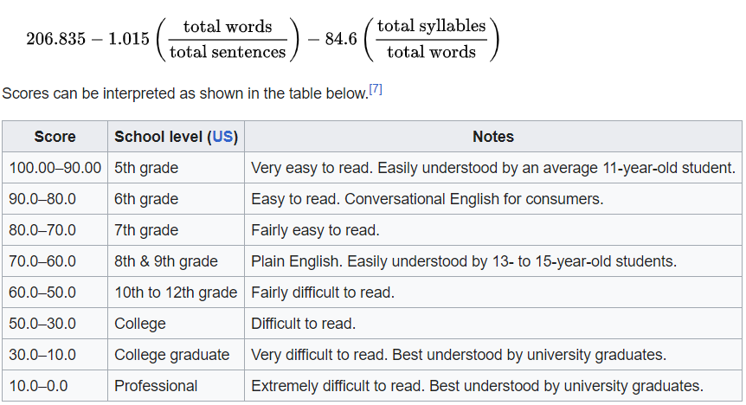
IMPLEMENTATION
3. Ranking Resources – Document Ranking
Scoring Resources: To categorize retrieved documents into High, Medium, and Low levels of complexity, we employed the Flesch-Kincaid Grade method.
Flesch-Kincaid Grade Score: This method assigns a readability score to each resource, which in turn is used to determine its grade level.
Relevance Ranking within Each Level: Within each level, resources are further ranked based on their relevance scores which are defined previously.
IT20133368 | Wijayasena W.D.N.D.T. | 2023-035

Slide 67
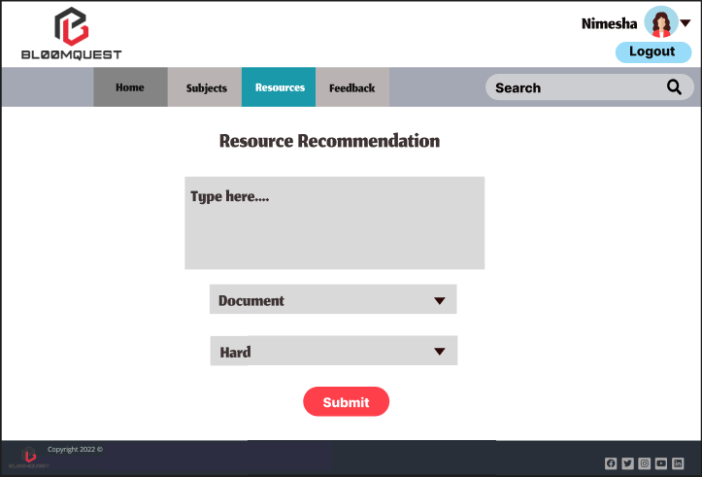
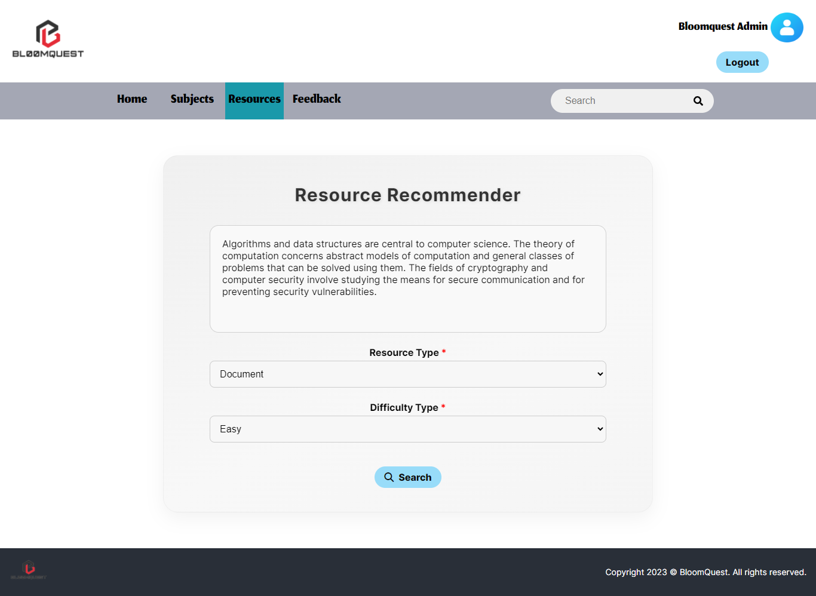
PROTOTYPE VS UI DESIGN
Prototype
UI Design
IT20133368 | Wijayasena W.D.N.D.T. | 2023-035

Slide 68
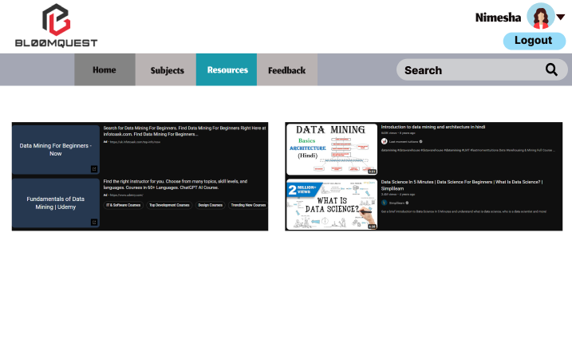
PROTOTYPE VS UI DESIGN
UI Design
Prototype
IT20133368 | Wijayasena W.D.N.D.T. | 2023-035

Slide 69
NON-FUNCTIONAL REQUIREMENTS
Response Time: The system need to provide recommendations within a reasonable time frame, typically within a few seconds.
Accuracy:
Recommendation Accuracy: The system should provide highly relevant and accurate resource recommendations to users.
Topic Modeling Accuracy: The topic modeling and content analysis should be precise in identifying relevant educational topics.
Availability, ensuring students can access it when needed.
IT20133368 | Wijayasena W.D.N.D.T. | 2023-035

Slide 70
FUTURE WORK
Reduce document processing time.
Improve accuracy.
Testing.
IT20133368 | Wijayasena W.D.N.D.T. | 2023-035

Slide 71
COMMERCIALIZATION
BloomQuest Lite (Free Version)
BloomQuest Premium (100$ Annually)
Basic quizzes focused primarily on the lower levels (Remember & Understand) of Bloom's Taxonomy will be generated.
Suggest extra resources up to only 3 times per day.
Show a basic or partial mind map, providing a glimpse.
Display non-intrusive advertisements.
Quizzes will be generated to cater all levels of Bloom's Taxonomy.
Performance prediction based on historical data.
A detailed dashboard visualizing student's performance across various levels of Bloom's Taxonomy.
Unlimited suggestions of extra resources.
Full access to mind maps with downloading feature.
Ad-Free Experience.
Project ID : 2023-035

Slide 72
BUSINESS PLAN
Target Audience
University Students.
Homeschooling Parents.
Educational Institutions.
Adult Learners & Lifelong Learners
Marketing Plan
Social Media Marketing Campaigns.
Awareness Session for Students.
Email Marketing for Educational Institutions.
Project ID : 2023-035

Slide 73
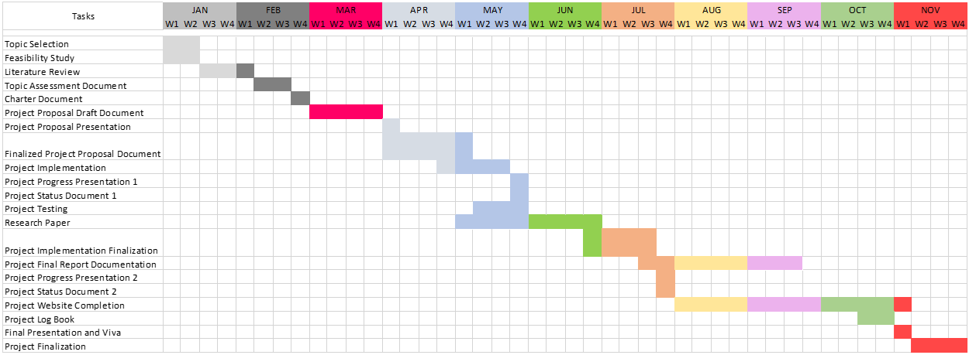
GANTT CHART
Project ID : 2023-035

Slide 74
Thank you.
Project ID : 2023-035

